Slide 1

TO-DO APP
Group: Sang Nguyen & Haiqa Noor

Slide 2


Project Aim & Overview
Objective: Develop a secure web-based To-Do application.
Users can register, log in, and manage tasks securely.
Main Features:
- Secure user authentication and session handling
- Task management with CRUD operations
- Focus on secure programming principles
Backend
Python, Django
Django REST Framework
PostgreSQL, Docker

Slide 3


Tools and Frameworks Used
Backend
Python, Django
Django REST Framework
PostgreSQL, Docker
Security Libraries
Frontend
- React, TypeScript
- Axios, React Query
- djangorestframework-simplejwt
- django-ratelimit
- django-cors-headers

Slide 4
Tools and Frameworks Used
Backend
Security Libraries
- djangorestframework-simplejwt
- django-ratelimit
- django-cors-headers
Python, Django
Django REST Framework
PostgreSQL, Docker
Frontend
- React, TypeScript
- Axios, React Query

Slide 5
Tools and Frameworks Used
Backend
Security Libraries
Frontend
- React, TypeScript
- Axios, React Query
- React-hook-form
- MUI library
- djangorestframework-simplejwt
- django-ratelimit
- django-cors-headers
Python, Django
Django REST Framework
PostgreSQL, Docker

Slide 6

Secure Programming Implementations
Backend:
- JWT authentication with access/refresh tokens
- CSRF protection via middleware
- SQL injection prevention using ORM
- Strong password hashing (PBKDF2)

Slide 7
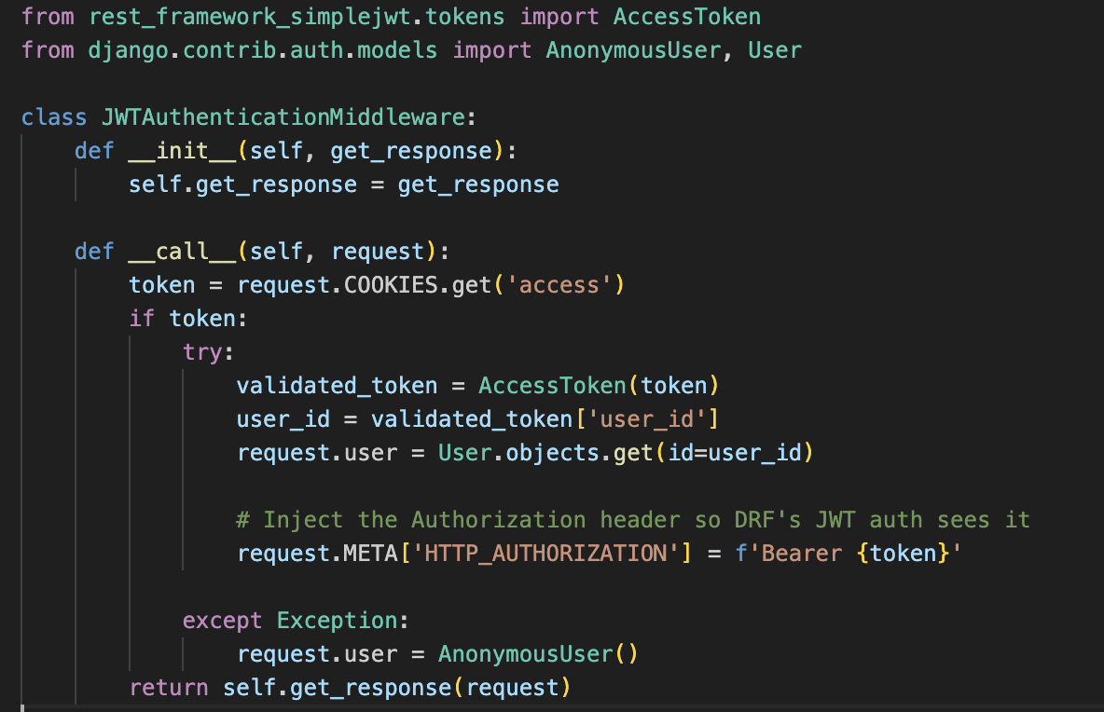
Secure Programming Implementations

Slide 8
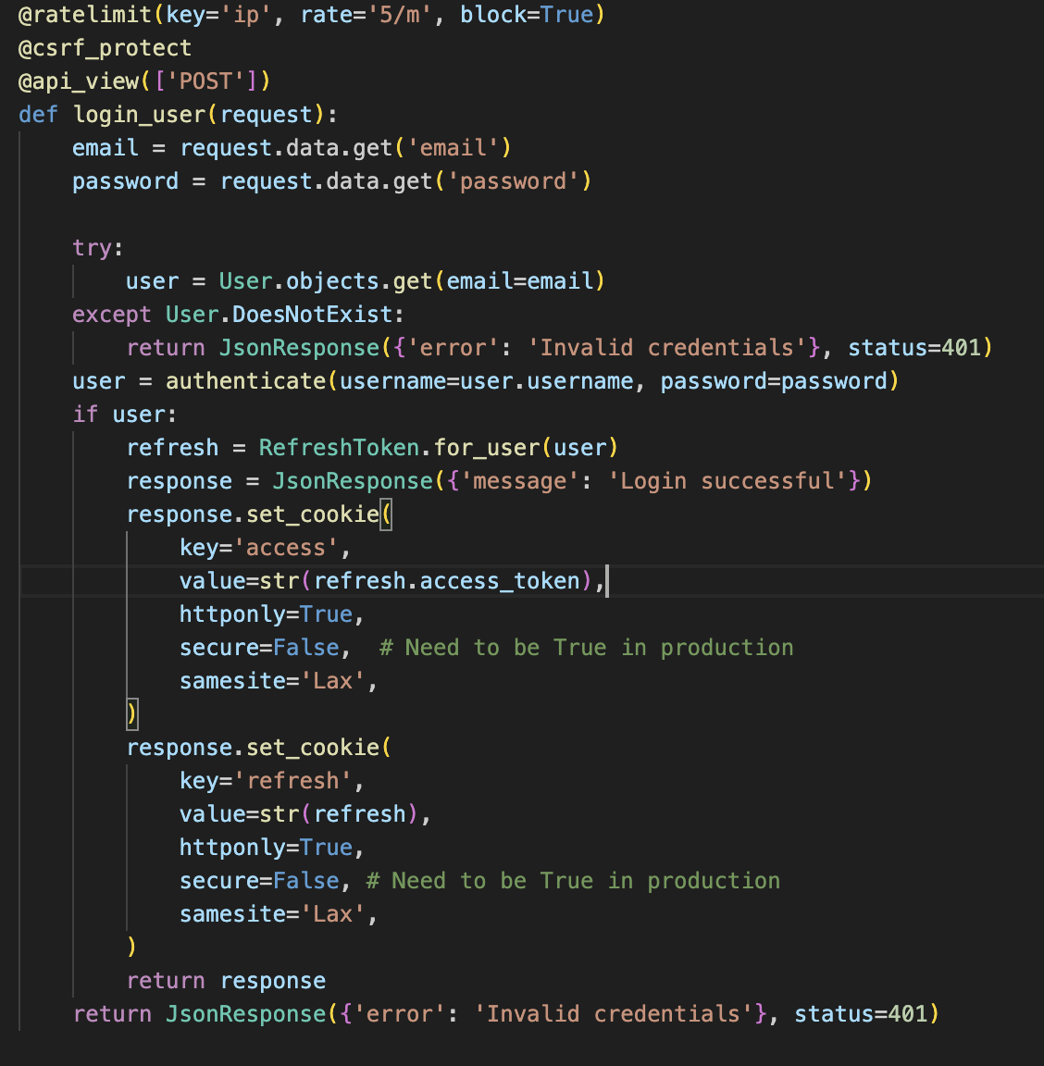
Secure Programming Implementations

Slide 9

Secure Programming Implementations
Frontend:
- Input validation to prevent XSS
- JWT tokens handled in HttpOnly cookies
- Role-based access UI restrictions

Slide 10
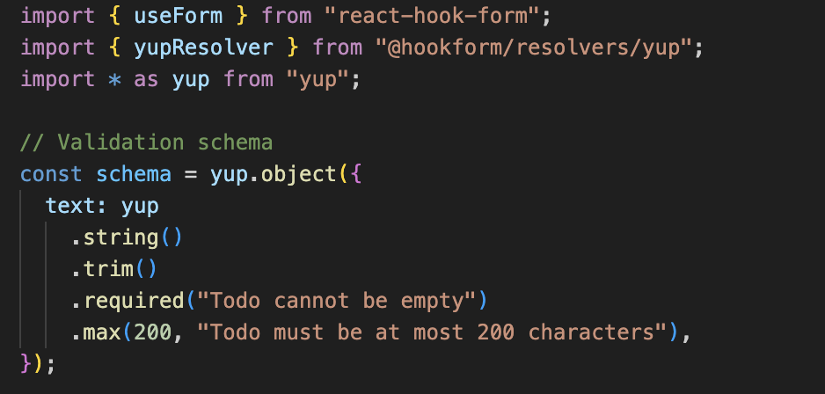
Secure Programming Implementations

Slide 11
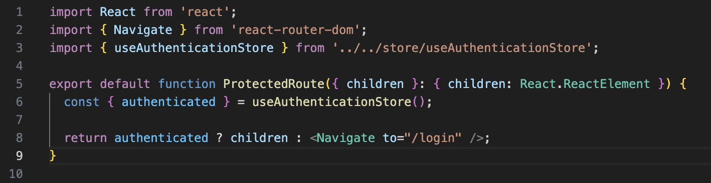
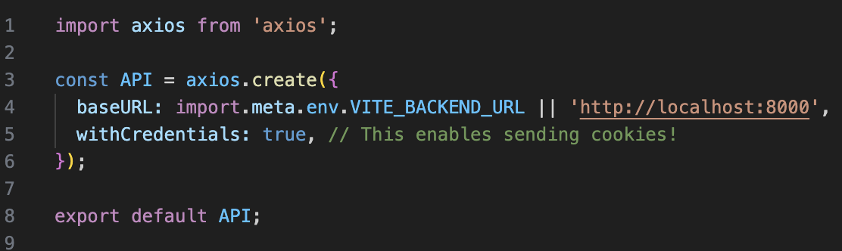
Secure Programming Implementations

Slide 12
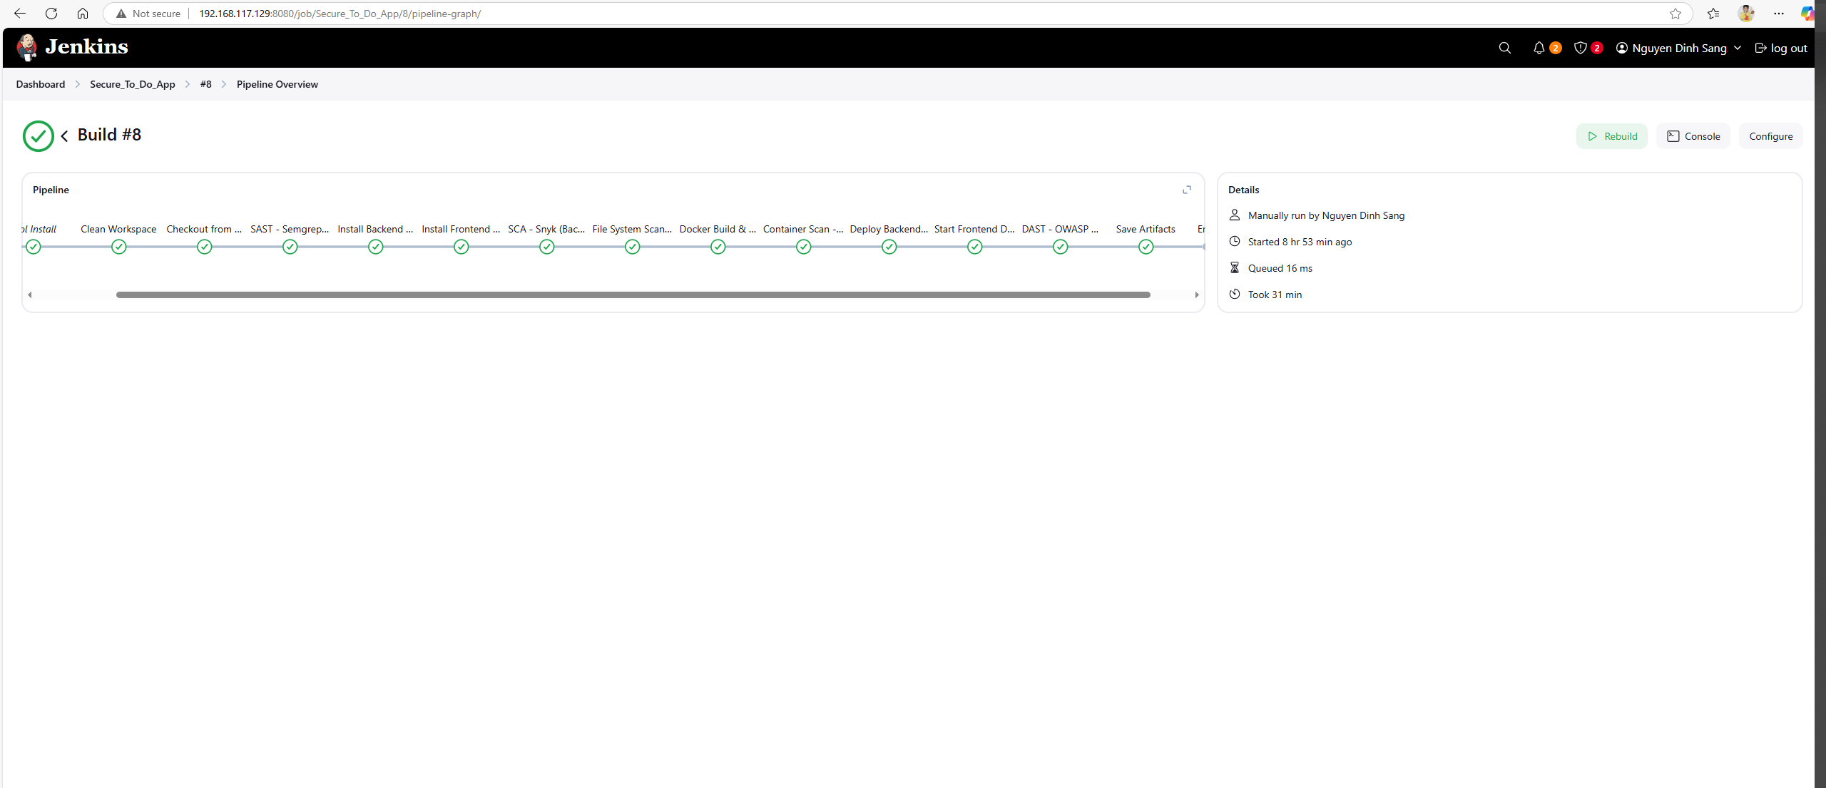
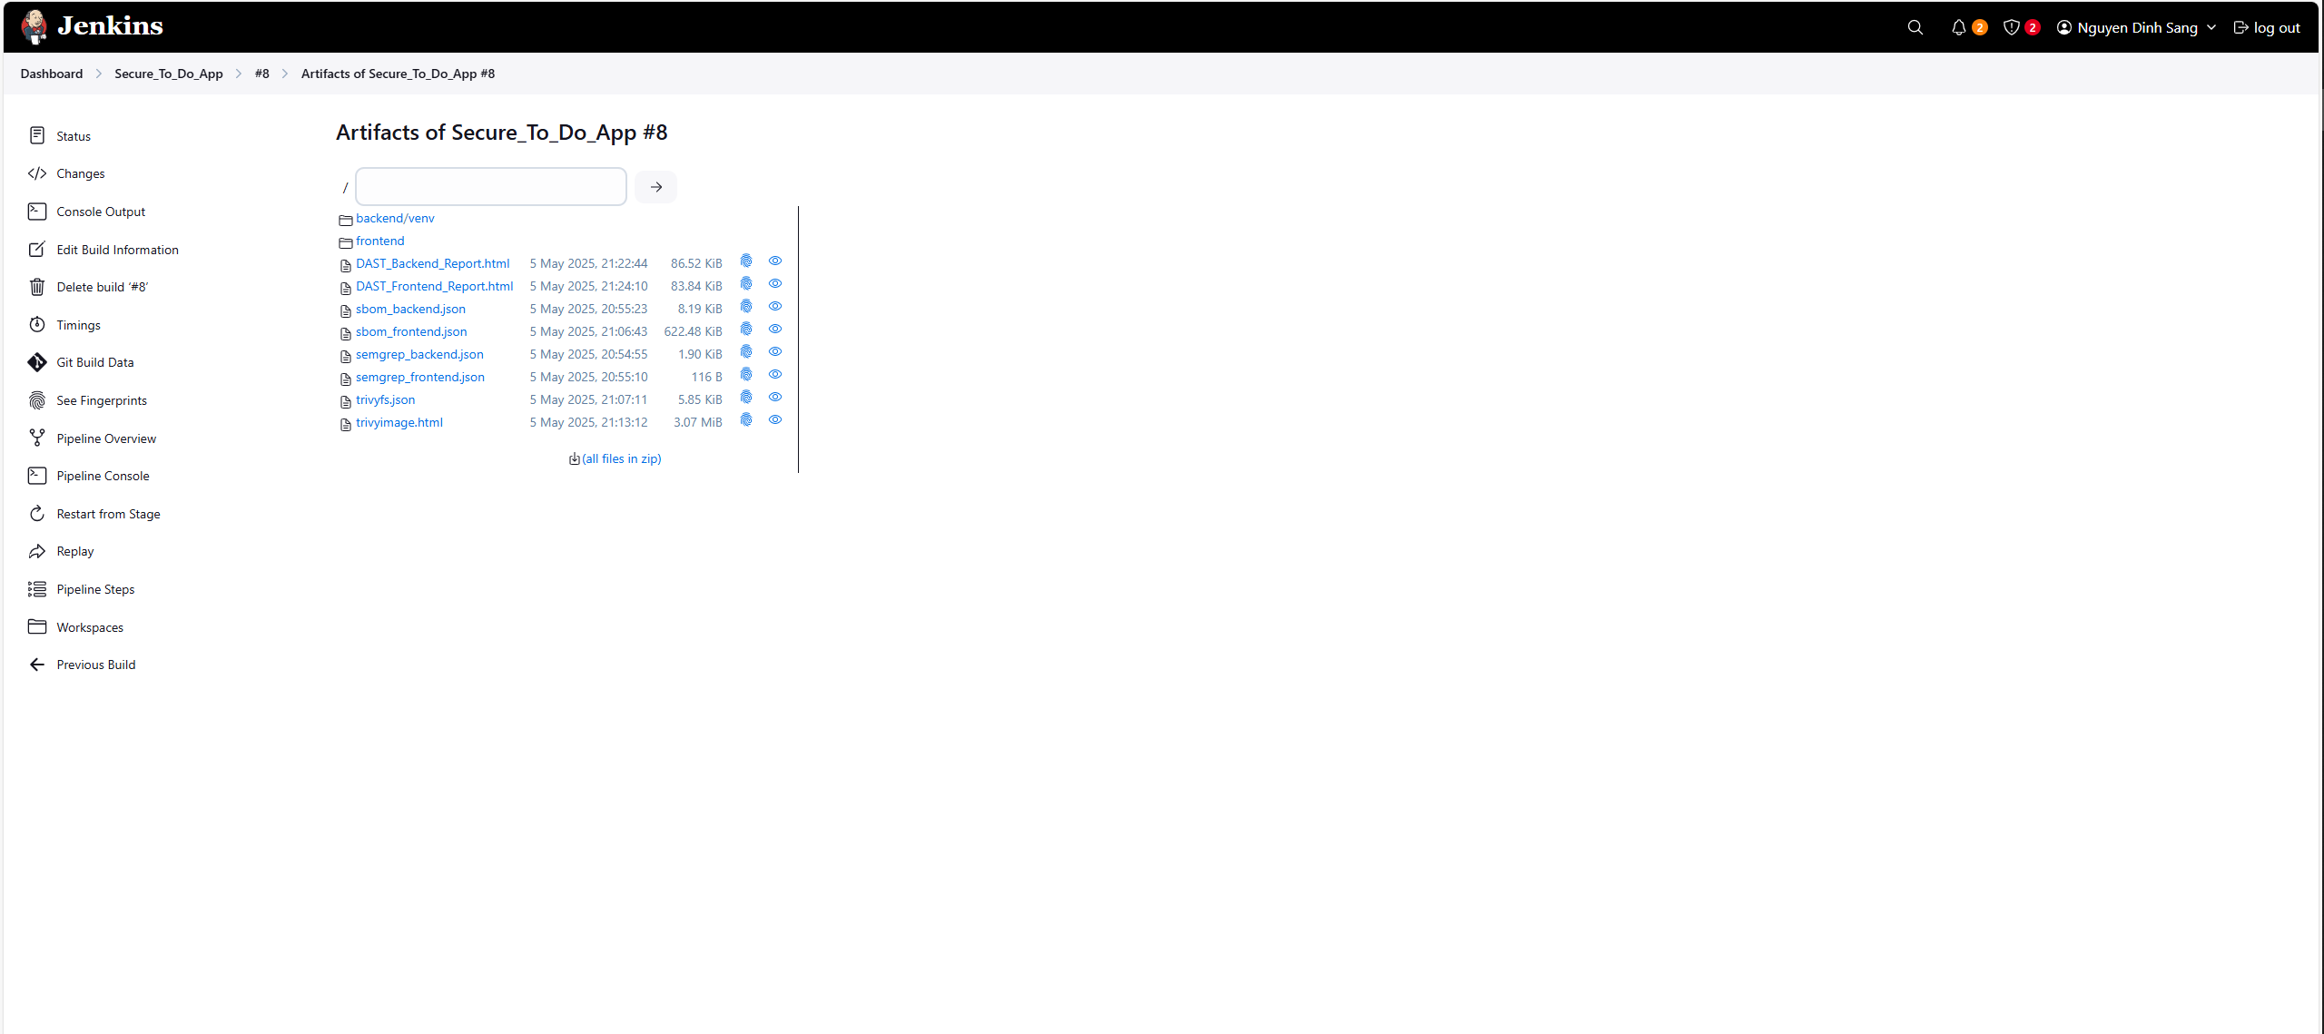
Testing & Results

Slide 13

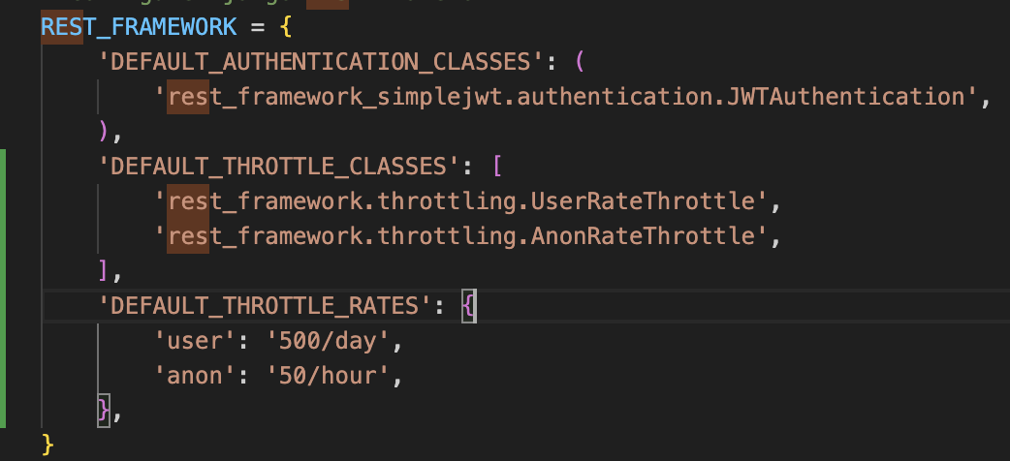
Testing & Results
SAST – Static Application Security Testing
Frontend: No issue found
Backend: missing throttling configuration
Solution: Add Django REST Framework
throttling settings and Django_ratelimit

Slide 14


Testing & Results
SCA – Software Composition Analysis
Generate SBOM for backend and frontend
For frontend, snyk tested 110 dependencies
for known issues, no vulnerable paths found.
For backend, snyk tested 12 dependencies for
known issues, found 1 issue, 1 vulnerable path.
djangorestframework-simplejwt@5.5.0
snyk

Slide 15
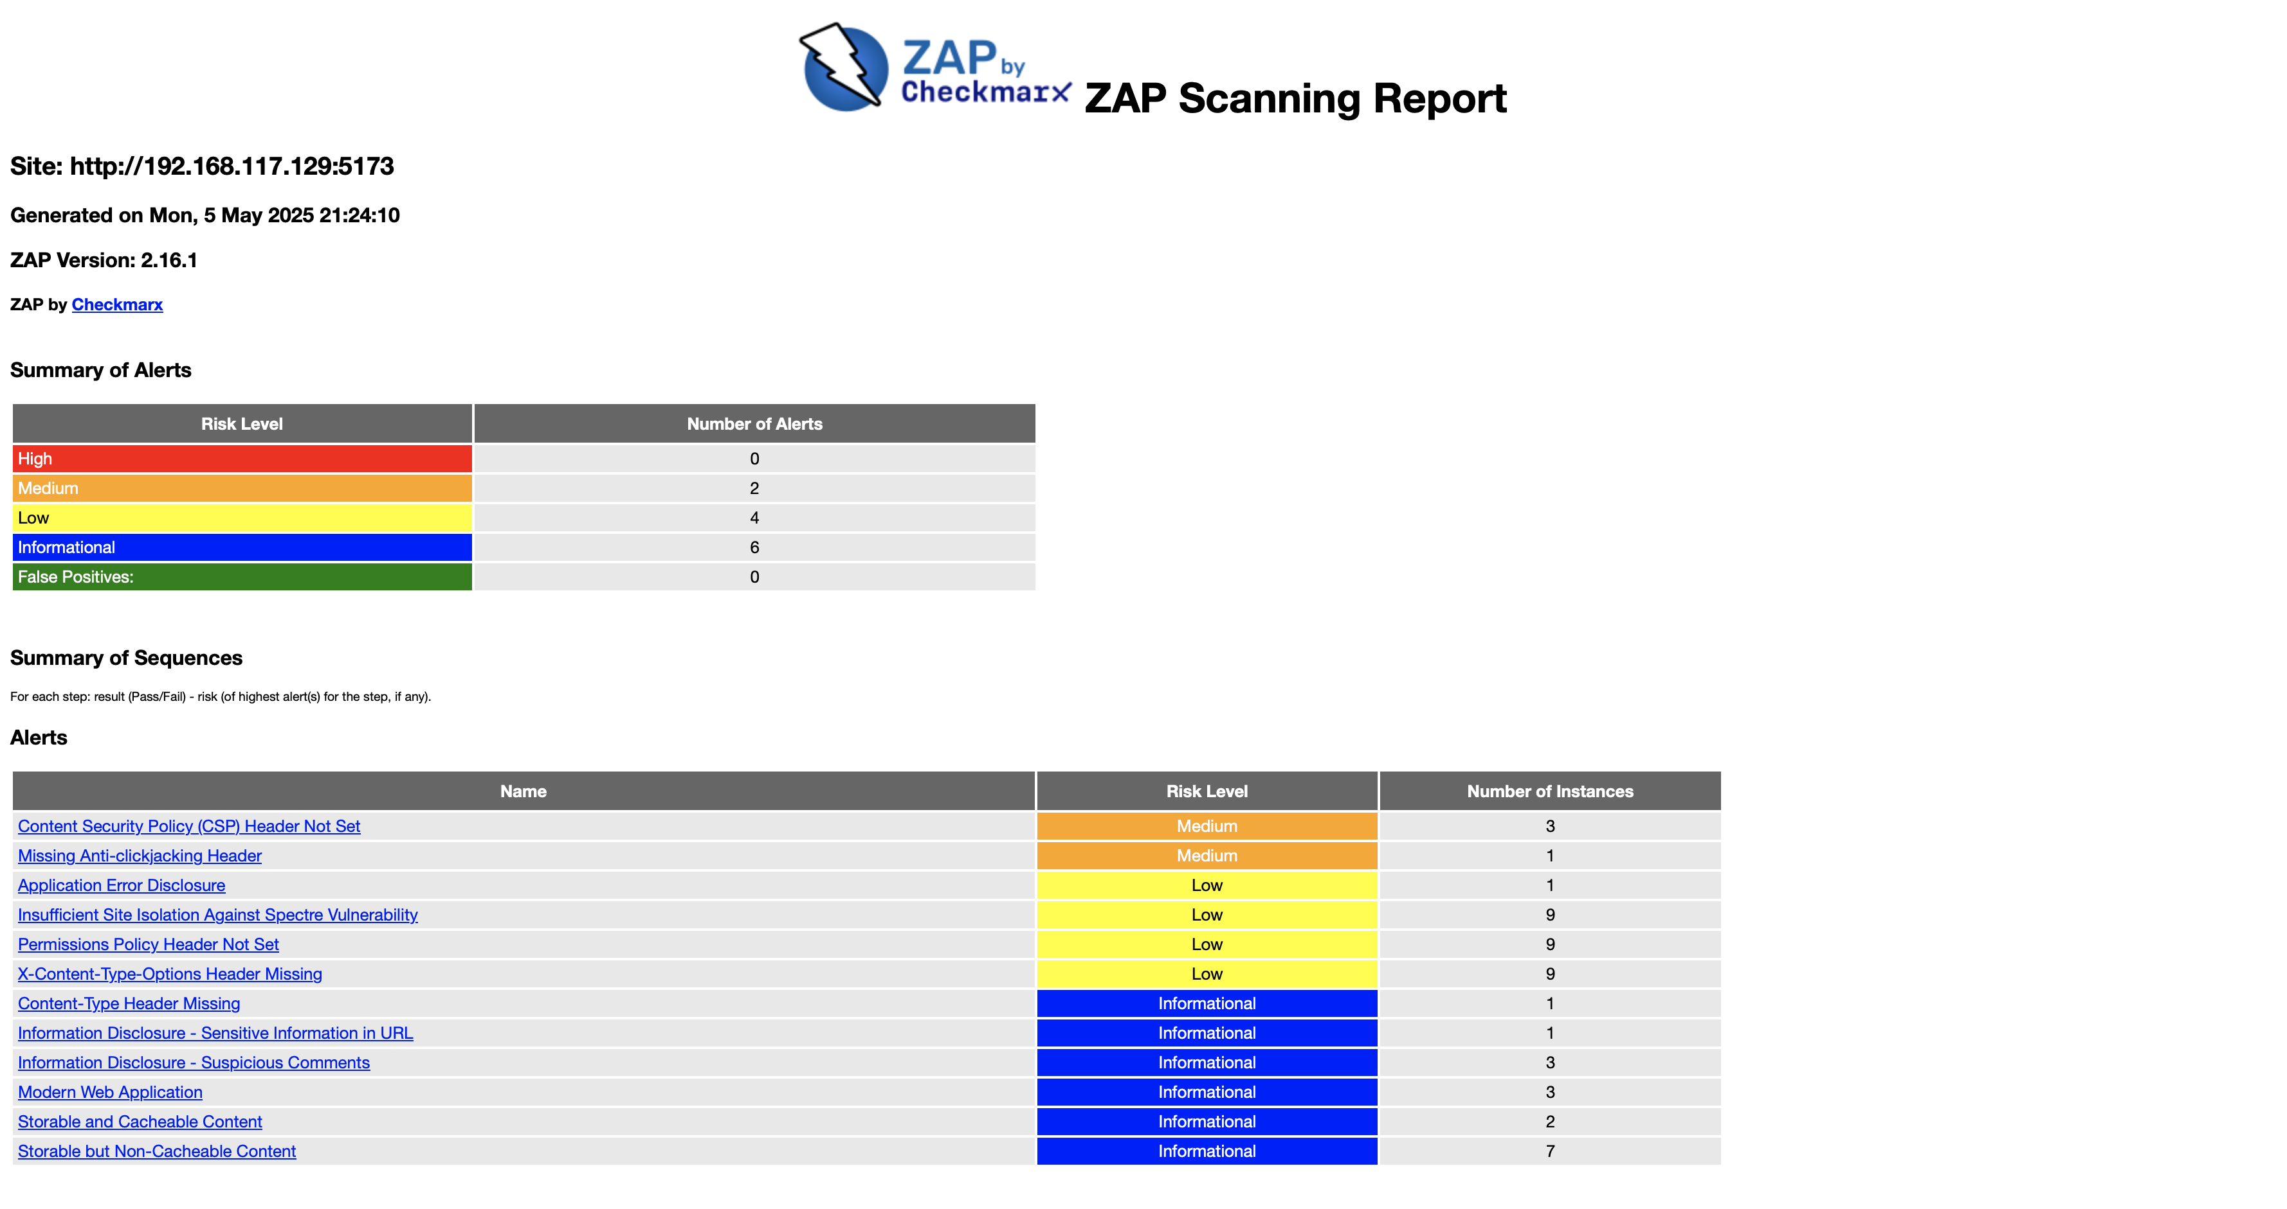

Testing & Results
DAST – Dynamic Application Security Testing

Slide 16
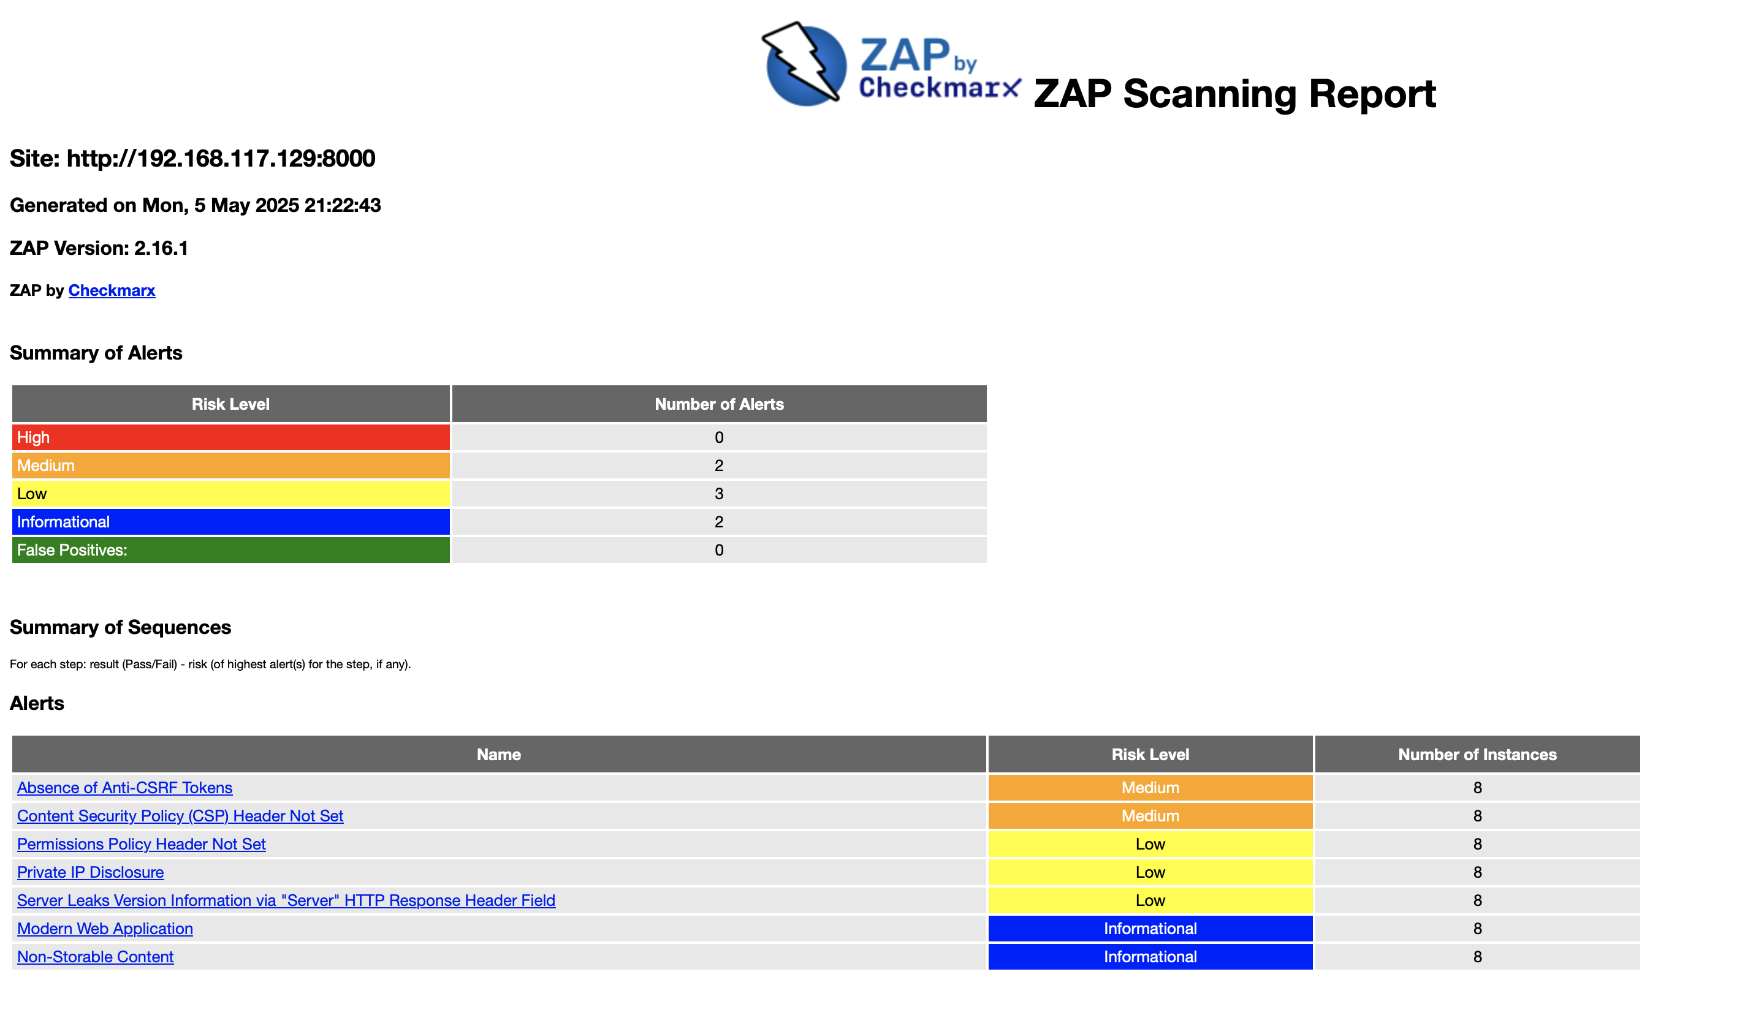
Testing & Results
DAST – Dynamic Application Security Testing

Slide 17
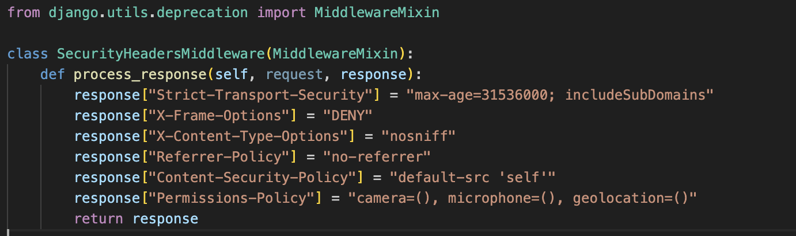
Testing & Results
DAST – Dynamic Application Security Testing

Slide 18

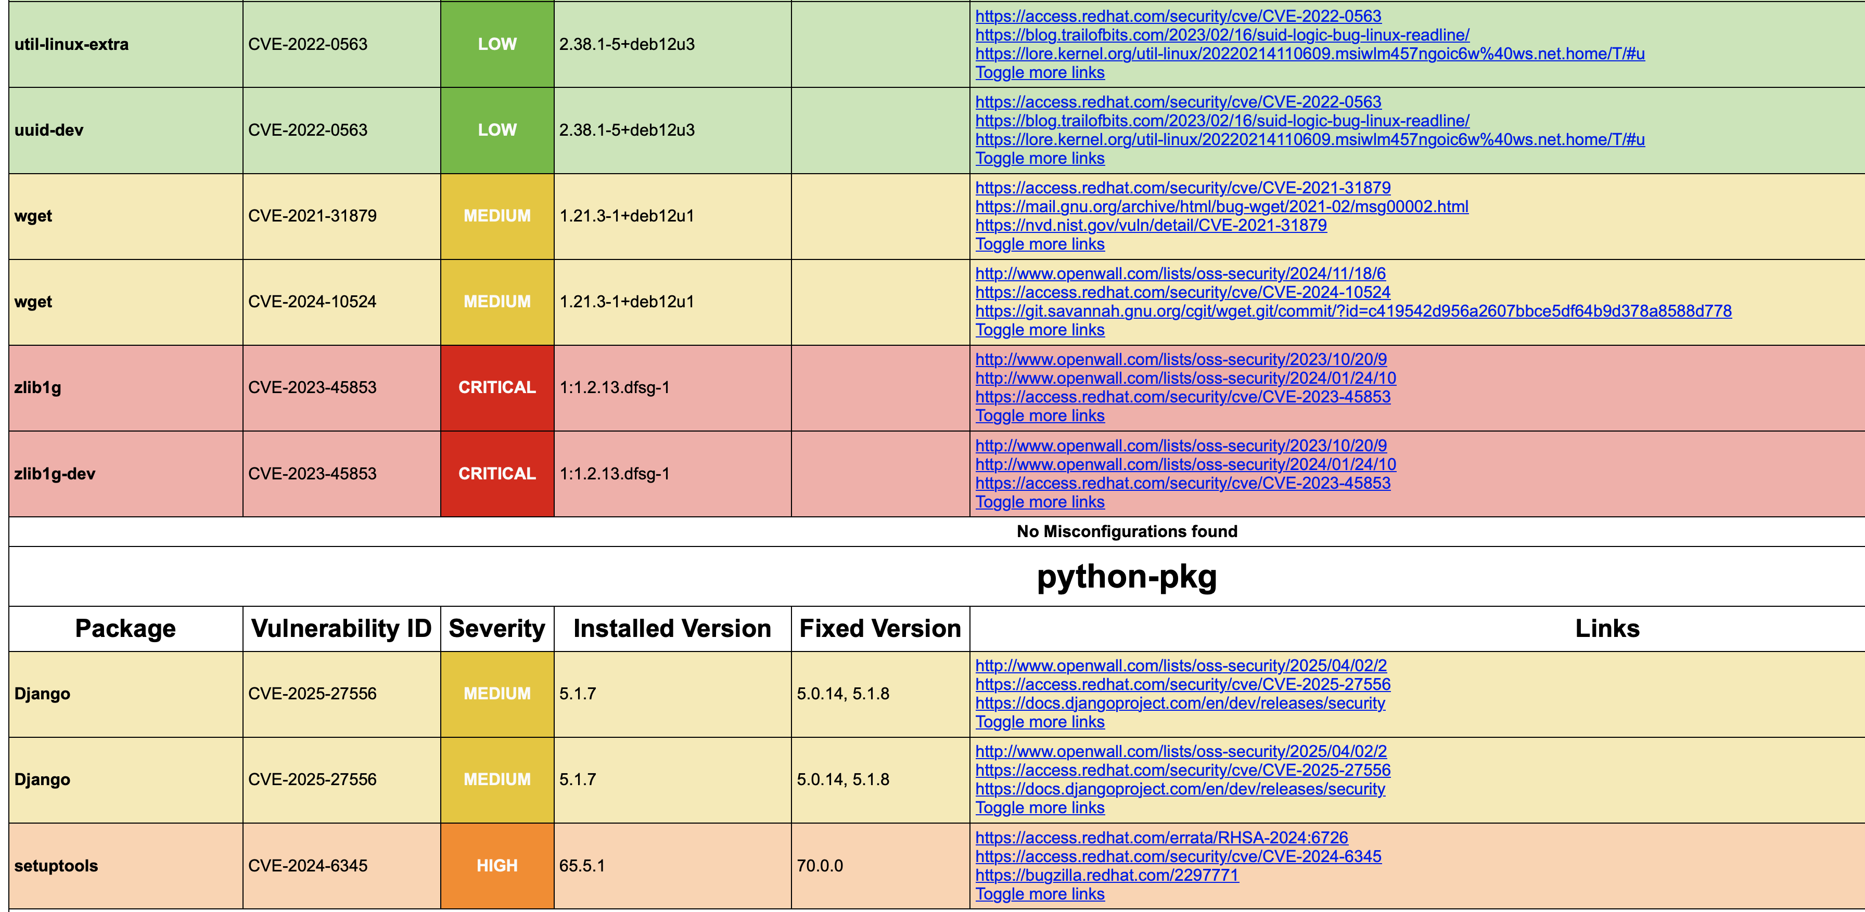
Testing & Results
Trivy File System & Container Scanning:

Slide 19


AI Usage

Slide 20
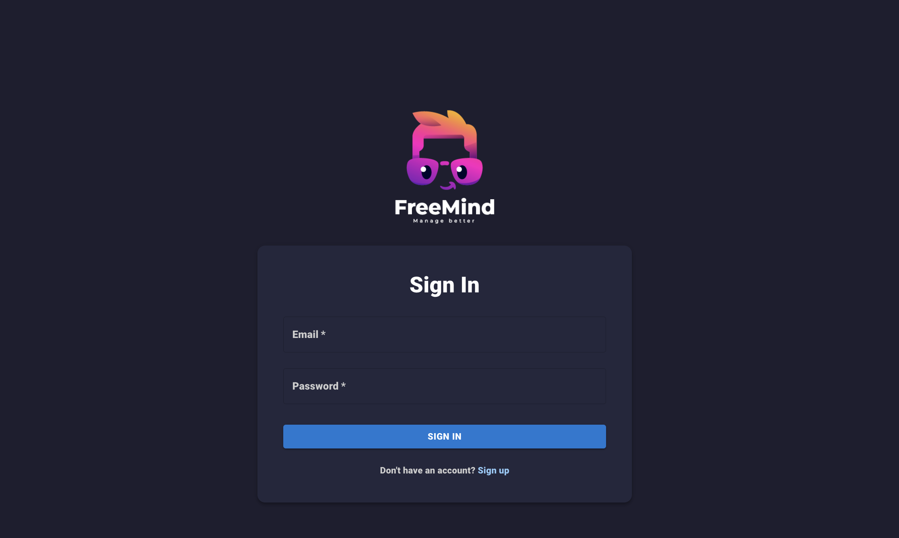
Application Demo

Slide 21
Thank you for listening

